Slide 1
Time-series analysis
(trend analysis and modelling)

Slide 2
Read/Extract time series data
Plotting time series
Trend analysis
Change detection

Slide 3
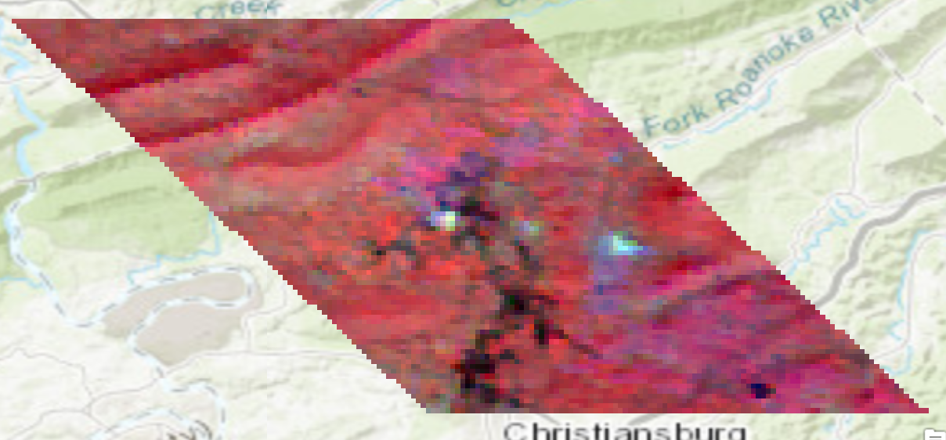
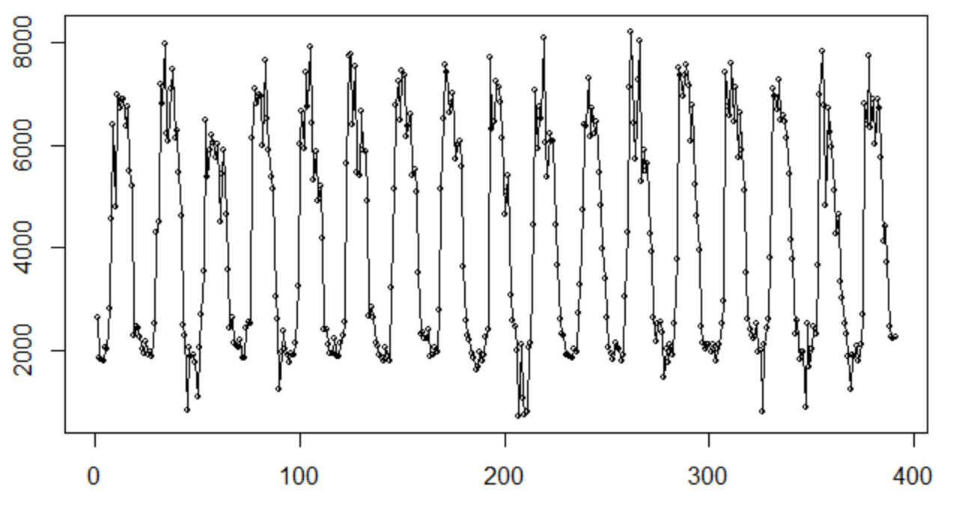
More examples: remote sensing time-series data
2001-2017
Each year 23 observations

Slide 4
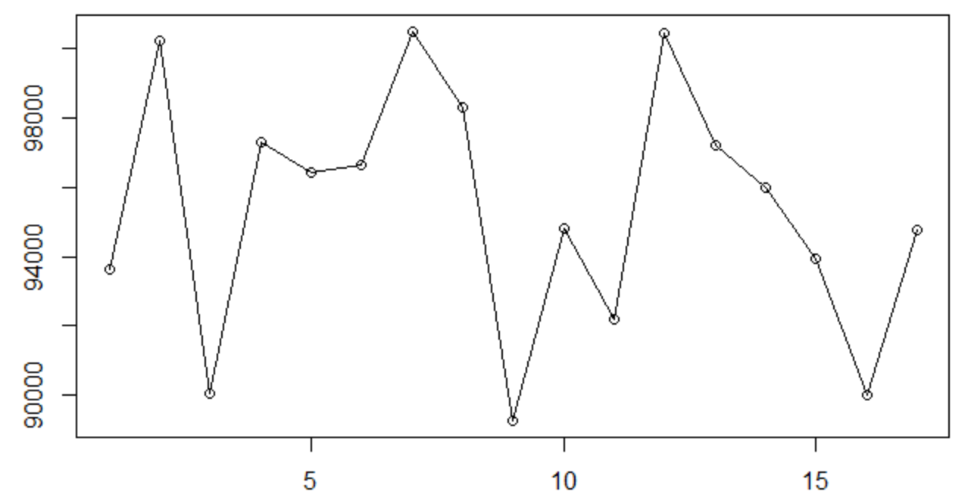
Annual-EVI (2001-2017)

Slide 5
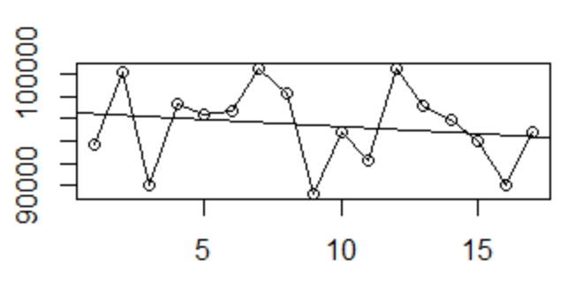
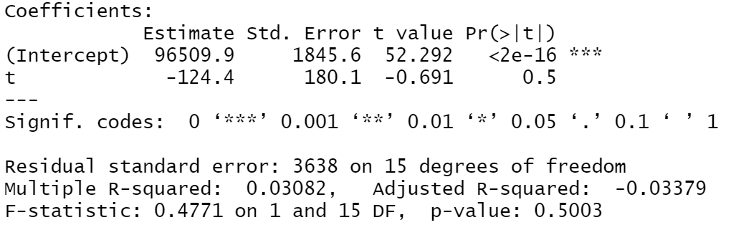
Trend analysis
Regression line (y~a+b*t)
NDVI against time (year)

Slide 6
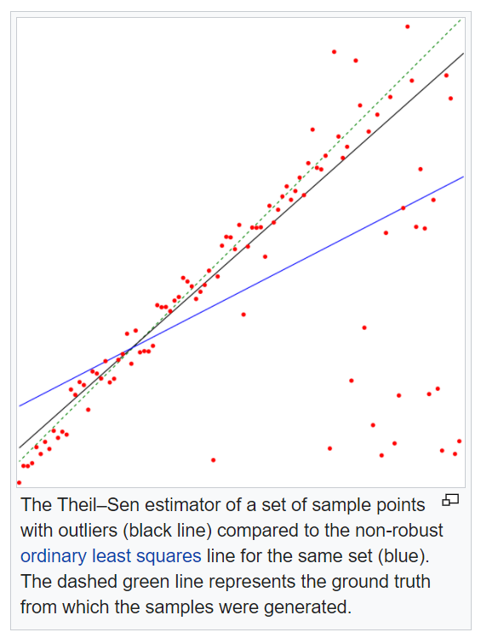
Rscript demo: trend analysis
1. The usual method for estimating the slope of a regression line that fits a set of (x, y) data elements is based on a least squares estimate.
lmodel<-lm(ndvi~year,data=df)
2. Sen’s slope:
Nonparametric estimate of the slope; Sen’s slope is defined as the median m of the slopes (y_{j} − y_{i})/(x_{j} − x_{i}) determined by all pairs of sample points
library(trend)
sens.slope(ndvi,conf.level = 0.95)
Source: https://en.wikipedia.org/wiki/Theil%E2%80%93Sen_estimator

Slide 7
R wee6 (week7) demo

Slide 8
Lab 5 Q3
Fit trend line (or Sen’s slope) for each pixel?

Slide 9
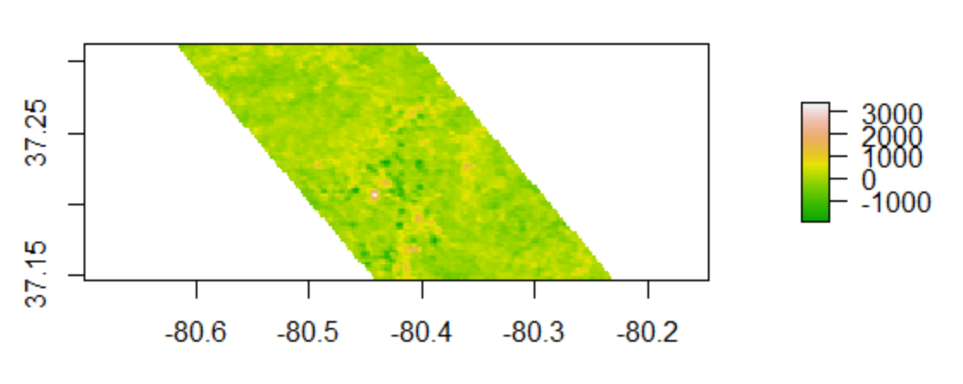

Slide 10
Useful tools/methods for Q3
For loop
for (i in 1:n){
mymodel<-lm(ndvi ~ t)
}
Data preparation: stack image
Convert to matrix (or dataframe)
Build linear model for each row (or pixel)

Slide 11
Convert to matrix (or data frame) - df
Pixel | ndvi2001 | ndvi2002 | … |  |  |  | ndvi2017
1
2
.
.
.
n row
t<-1:17
Build a linear regression model for each row.
for (i in 1:n) {
y<-df[i,]
model1<-lm(y~t)
}

Slide 12
Deal with NoData issue

Slide 13
if else statement
if (a==1) {print(a) }
x <- runif(10, 0, 100)
for (i in 1:length(x)){
if (x[i]>50){print('yes’)}
else(print('no’))
}

Slide 14
Q3
if (!is.na()) {model1<-lm()}

Slide 15
Reading Time Series Data
Plotting Time Series
Trend analysis
Change detection

Slide 16
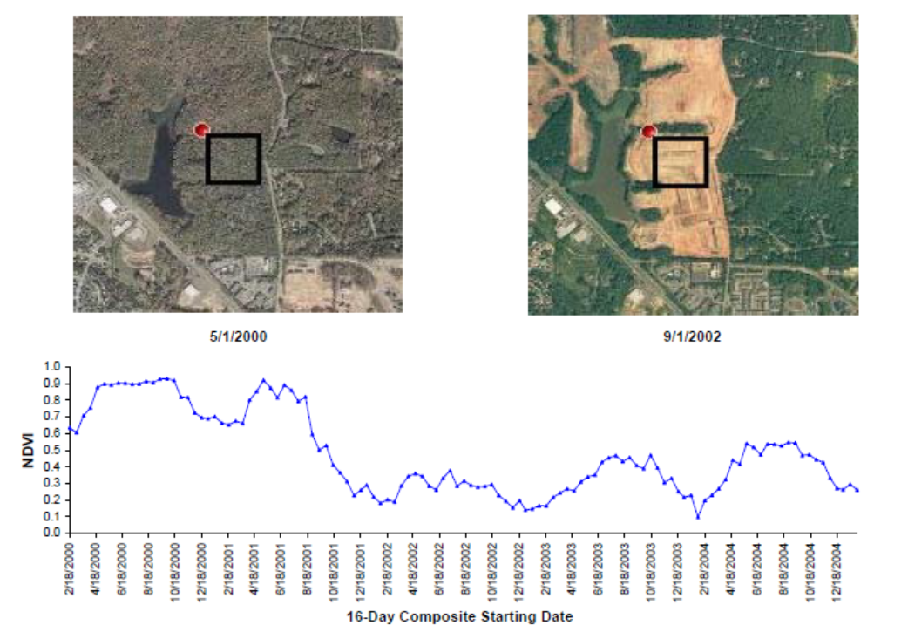

Slide 17
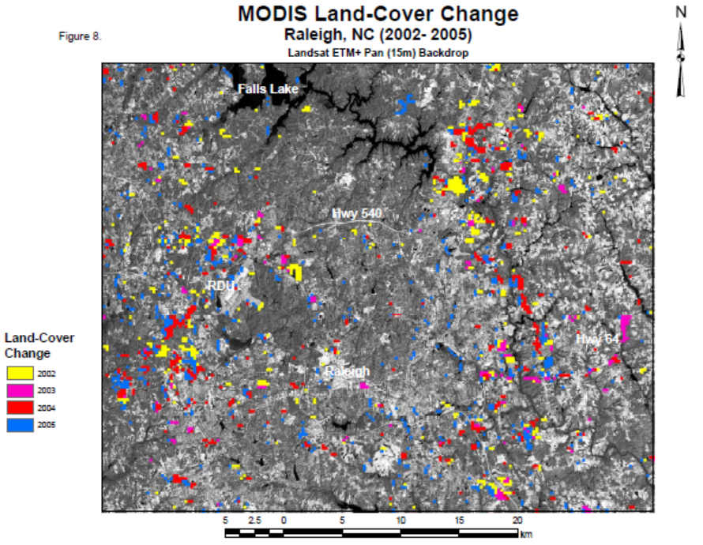

Slide 18
Source: Lunetta et al. 2006

Slide 19
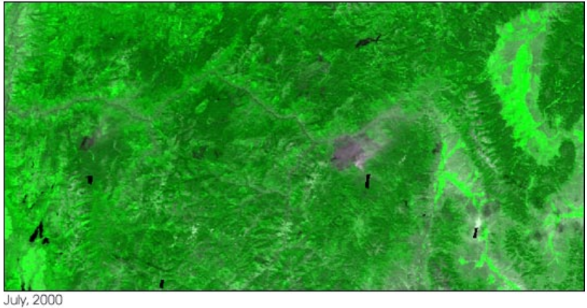
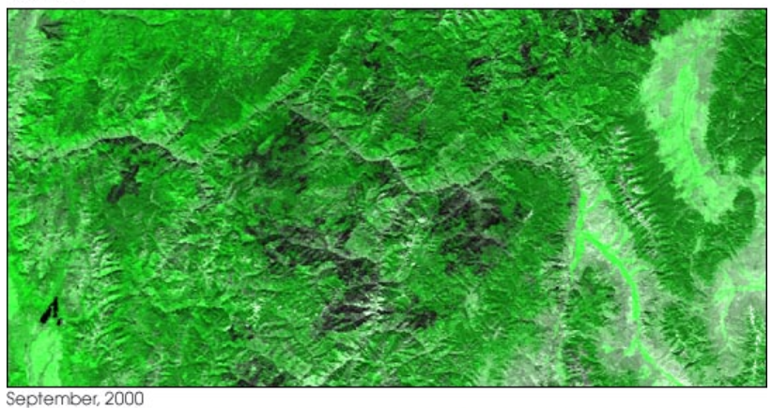
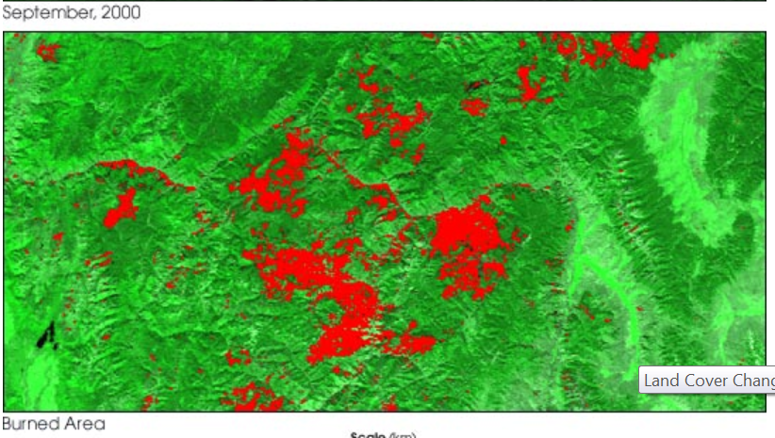
Wildfire detection
“MODIS’ 250-m resolution product will serve as an alarm system that warns scientists of possible significant land cover change. Scientists can then turn to higher-resolution sensors such as Landat-7, ASTER, or Ikonos for a detailed look at an area.”

Slide 20
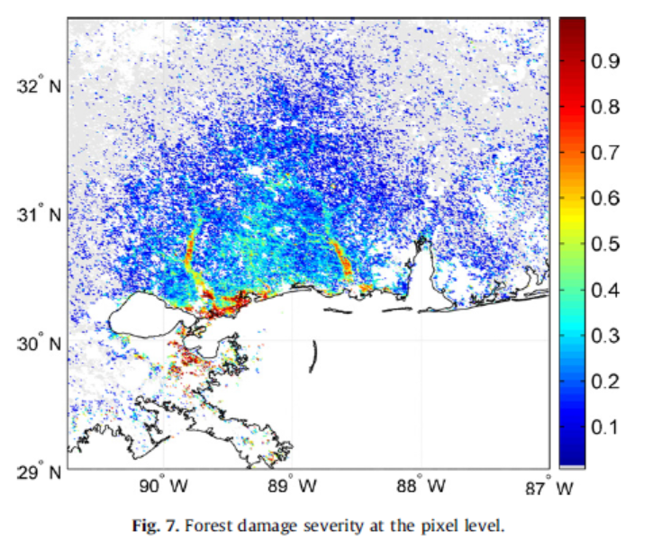
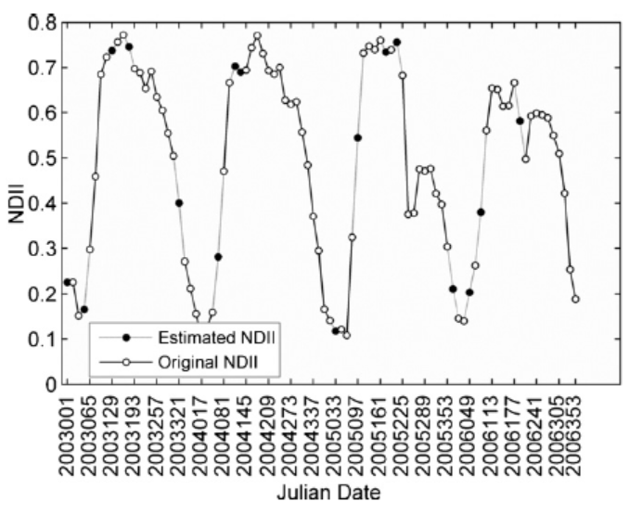
Post-hurricane forest damage assessment
Post-Hurricane Katrina
(Wang et al. 2010)

Slide 21
R script and demo
library(changepoint)
a<-readOGR('.',layer='blacksburg')
a_proj<-spTransform(a,crs(m))
avalue<-extract(m,a_proj)
plot(avalue[1,])
fit_changepoint = cpt.mean(avalue[1,])
plot(fit_changepoint)
cp <- cpts(fit_changepoint)

Slide 22

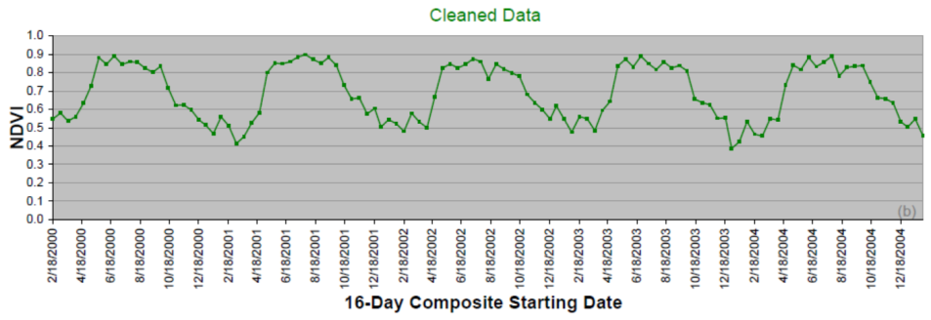
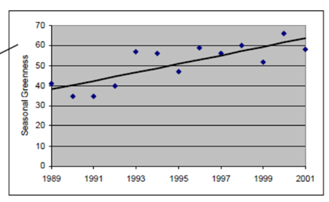
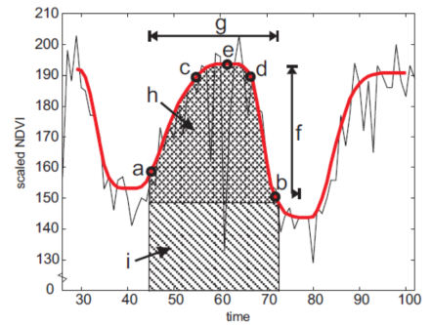
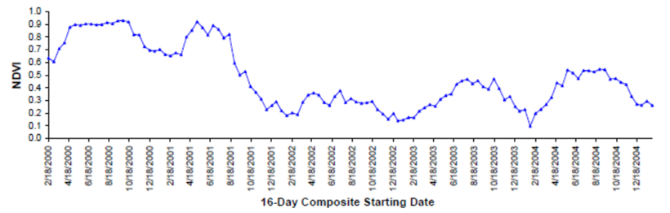
Analysis of Time Series Remote Sensing Data
Identify changes
Analyze trends
Estimate seasonality
parameters
• Human activity
Natural disaster
Temperature
• Precipitation
…..

